Slide 1
Automatic watering system for plants Deciding Buying and Testing of Components
Submitted by:
Induja Sudhish(c0769921)
Group 6

Slide 2
Deciding and buying of the components

Slide 3
List of components
Beagle bone Black
Soil Moisture Sensor(FC-28)
Temperature and Humidity Sensor(DHT22)
Light Sensor(LDR)
Motor Driver(L293D)
DC motor(12V)
Resistors &Capacitors
Power Supply
WIFI Module(esp8266 Wi-Fi module)
Jumper wires
Soldering kit
Zero PCB

Slide 4
Beagle Bone Black
It is a powerful ARM technology based development
board which is widely adopted in embedded applications.
Here we are using Beaglebone Black REV C with
1 GHz processor and 512 MB onboard DDR3 RAM.
It comes with a mini-B cable for powering it up.
As the BBB has onboard flash storage no micro SD
Card is included and also no SD card loading is
Required to get started.

Slide 5
Advantages of Using Beagle bone black
Beagle bone is considered to be more efficient to read data's from our sensors and to give commands to the motors.
It has 65 input and output pins and a huge
number of supported interfaces which makes
it the best choice for our project.

Slide 6
Availability of the component
The beagle bone black Rev c is available in various websites like amazon, Newark, Elmwood electronics.
https://www.amazon.ca/Beagleboard-BBONE-BLACK-4G-BeagleBone-Rev-C/dp/B00K7EEX2U
Currently it is available in amazon for $142.02

Slide 7
Soil moisture sensor(FC-28)
This is used to measure the moisture content of the soil by using the two probes which is attached to the sensor which act as a variable resistor.
This sensor will measure the
volumetric content of the water.
The more water in the soil means better the conductivity between the probes and result in a lower resistance and higher the AOUT.

Slide 8
The specifications of the FC-28 soil moisture sensor are as follows:
Input Voltage: 3.3–5V
Output Voltage: 0–4.2V
Input Current: 35mA
Output Signal: both analog and digital

Slide 9
Pin-out:
The FC-28 soil moisture sensor has four pins:
VCC: Power
A0: Analog Output
D0: Digital Output
GND: Ground

Slide 10
To connect the FC-28 in digital mode we will connect the digital output of the sensor to the digital GPIO pins of the beagle bone black.
There is a potentiometer in the sensor module, which
is used for setting the threshold value.
The threshold value is then compared using the LM393
comparator, which is mounted on the sensor module, with the sensor output value.
The comparator LM393 measures the output value of
the sensor and the threshold value, and then provides us with the output via the digital pin.

Slide 11
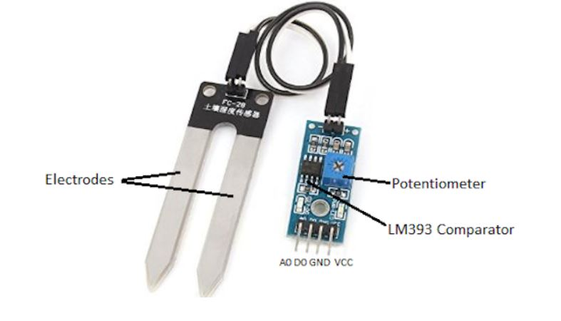

Slide 12
Advantages of FC-28 Soil moisture sensor
By using this sensor the irrigation system can be managed more efficiently and effectively.
This sensor uses one of the simple method for measuring the moisture content of the water.
And we can find out the result immediately.
This sensor can be used to connect in analog and digital modes

Slide 13
Availability
This is available in https://www.amazon.ca/FC-28-D-Hygrometer-Detection-Module-Moisture/dp/B00XPJ8O7E
It is available in various other websites like aliexpress.com

Slide 14
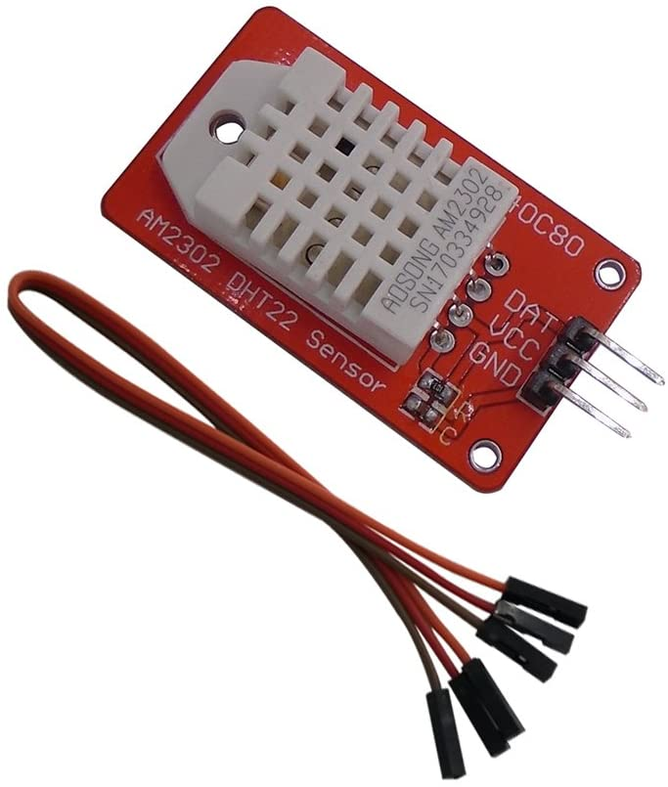
Temperature and Humidity sensor(DHT22)
This sensor is used to measure the surrounding air by using the capacitive humidity sensor and a thermistor and spits out a digital signal on the data pin.

Slide 15
Technical details
Low cost
3 to 5V power and I/O
2.5mA max current use during conversion (while requesting data)
Good for 0-100% humidity readings with 2-5% accuracy
Good for -40 to 80°C temperature readings ±0.5°C accuracy
No more than 0.5 Hz sampling rate (once every 2 seconds)
Body size 27mm x 59mm x 13.5mm (1.05" x 2.32" x 0.53")
4 pins, 0.1" spacing
Weight (just the DHT22): 2.4g

Slide 16
It comes in a case which has a humidity sensing component along with a NTC temperature sensor (or thermistor) on the sensing side.
The humidity sensing part is used to measure humidity, and is sandwiched between two electrodes with a moisture-holding substrate (usually a salt or conductive plastic polymer).
When water vapor is captured by it, the ions are emitted by the substrate, which in turn improves the conductivity between the electrodes.

Slide 17
The change in resistance is proportional to the relative humidity between the two electrodes.
The resistance between the electrodes is reduced by higher relative humidity, while lower relative humidity raises the resistance between the electrodes.
It consist of a NTC temperature sensor/Thermistor to measure temperature.
A thermistor is a thermal resistor-a resistor that with temperature changes its resistance.

Slide 18
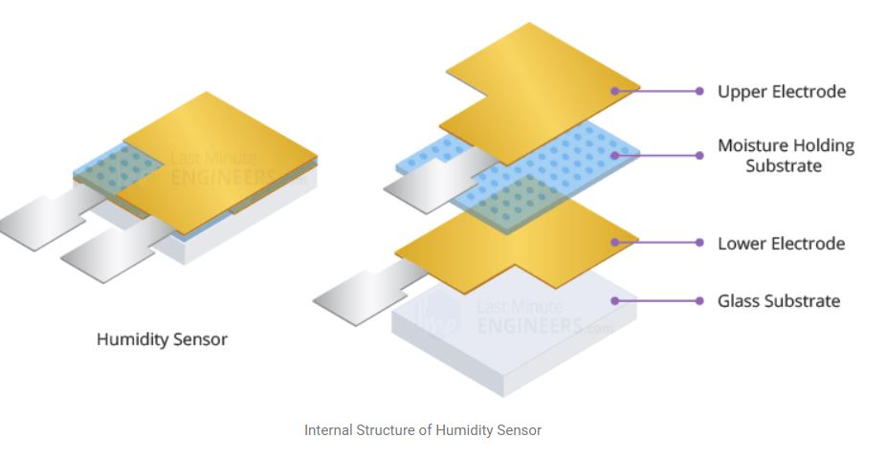
All resistors are theoretically thermistors, their resistance varies somewhat with temperature, but the change is typically very minor and difficult to measure.

Slide 19
Advantages of using DHT22 SENSOR
This is one of the most accurate sensors which is low in cost.
It is Good for -40 to 80°C temperature readings ±0.5°C accuracy.
the DHT22 sensor has better humidity measuring range, from 0 to 100% with 2-5% accuracy
Small size, low power consumption and long transmission distance are considered to be one of the important factors which makes it suitable for most of the harsh applications.

Slide 20
Availability
This sensor is available in Digi key, amazon, eBay, and various other websites.
https://www.amazon.ca/DSD-Temperature-Humidity-Arduino-Raspberry/dp/B07CM2VLBK/ref=asc_df_B07CM2VLBK/?tag=googleshopc0c-20&linkCode=df0&hvadid=293016807031&hvpos=&hvnetw=g&hvrand=4573677808363799697&hvpone=&hvptwo=&hvqmt=&hvdev=c&hvdvcmdl=&hvlocint=&hvlocphy=9000894&hvtargid=pla-465391317976&psc=1
It is available in amazon for $14.99

Slide 21
Light sensor(LDR)
Light dependent resistors, LDRs, or photoresistors are electronic components that are used to detect light & change the operation of a circuit dependent upon the light levels.
The light dependent resistors(LDR)are used to detect the presence of level of light in the model.
They provide large change in resistance for changes in light level.

Slide 22
Advantages of using LDR sensors
High sensitivity (due to the large area it can cover).
Easy employment.
Low cost.
There is no union potential.
High light-dark resistance ratio.

Slide 23
Availability
It is available online in various websites for different prices mostly around $2
https://www.robotshop.com/ca/en/mini-photocell-light-sensor.html?gclid=Cj0KCQiA962BBhCzARIsAIpWEL2DtgGV9yi9HhNMudu76prDjmgJlbcRUNOq9VWl2gqb1XqUw2-aROgaAviwEALw_wcB

Slide 24
Motor driver (L298N)
L298N chip can directly drive two 3-30V DC motor, here we are using a 12V DC motor.
The circuit will allow you to easily and independently control two motors of up to 2A each in both directions.
It is ideal for robotic applications and well suited for connection to a microcontroller requiring just a couple of control lines per motor

Slide 25
Advantages of L298N
The beagle bone has an output voltage of 5V, but the motor we are using require 12V to operate.
So to supply this high voltage to the Motor we ca use this motor driver in between the beagle bone and the Motor.
Beagle Bone
Motor Driver
Motor

Slide 26
Availability
It is available as a module in amazon.ca for $9.99
https://www.amazon.ca/PChero-Controller-Module-Stepper-Arduino/dp/B07GTCWN9Z/ref=asc_df_B07GTCWN9Z/?tag=googleshopc0c-20&linkCode=df0&hvadid=459480626555&hvpos=&hvnetw=g&hvrand=11366580824085057770&hvpone=&hvptwo=&hvqmt=&hvdev=c&hvdvcmdl=&hvlocint=&hvlocphy=9000894&hvtargid=pla-652109211542&psc=1

Slide 27
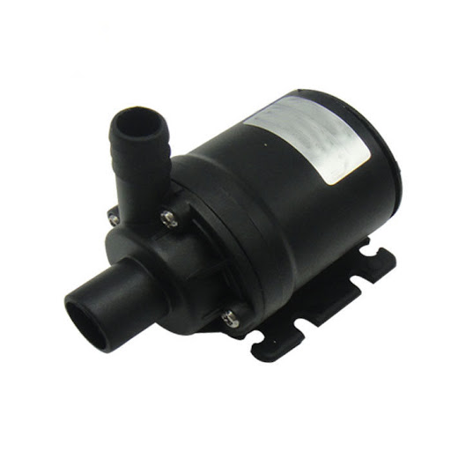
Water Pump
The motor is used in this project to pump water to the plants by receiving the command from the beagle bone black.
The beagle bone will sense the information from the sensors and send the command to run the motor accordingly.
In this project we are using a 12V water pump for the plants.

Slide 28
Availability
This available in amazon.ca for CAD 14.89
https://www.amazon.ca/LEDGLE-Submersible-Ultra-Quiet-Dual-Purpose-Hydroponics/dp/B07G74MDLM/ref=asc_df_B07G74MDLM/?tag=googleshopc0c-20&linkCode=df0&hvadid=335210432629&hvpos=&hvnetw=g&hvrand=11974487029324101271&hvpone=&hvptwo=&hvqmt=&hvdev=c&hvdvcmdl=&hvlocint=&hvlocphy=9000894&hvtargid=pla738142332843&psc=1

Slide 29
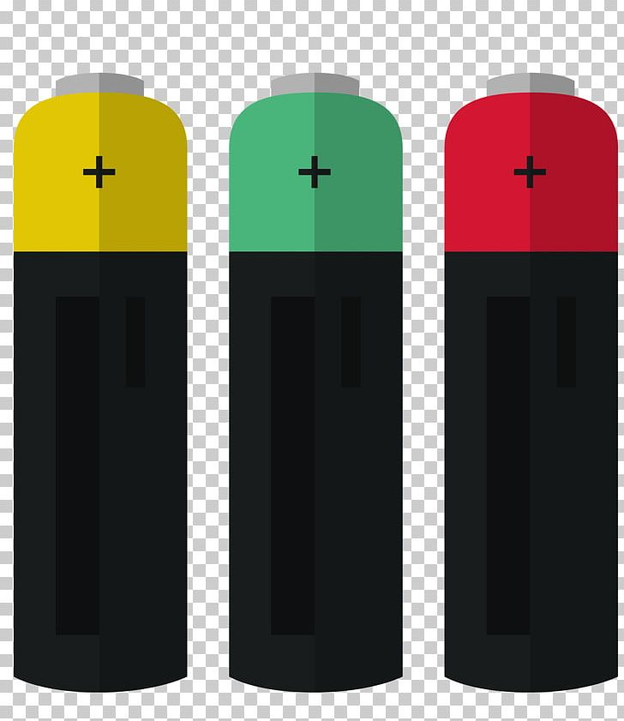
Power Supply
Here we are using a 5V battery to provide power to the beagle bone black and a 9 V battery to provide power to the motor driver which runs the motor.

Slide 30

WIFI module(ESP8266)
The ESP8266 Wi-Fi Module is a self contained SOC with integrated TCP/IP protocol stack that can give any microcontroller access to your Wi-Fi network.

Slide 31
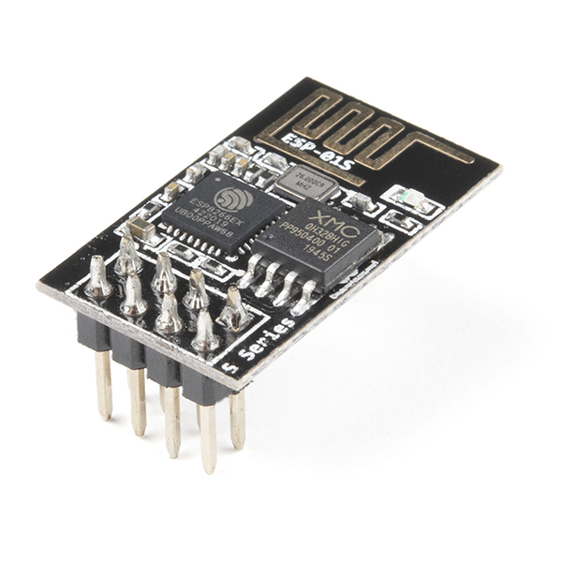
It is capable of either hosting an application or offloading all Wi-Fi networking functions from another application processor.

Slide 32
This module has a efficient on-board processing and storage capability that enables it to be implemented into its GPIOs with minimal up-front development and minimal loading during runtime with the sensors and other application specific equipment.
Every ESP8266 module comes pre-programmed with a firmware set of AT commands, which means you can simply connect it to your beagle bone and get as much Wi-Fi capability as a Wi-Fi Shield provides.

Slide 33
Availability
This available in Robot shop for CAD 6.53
https://www.robotshop.com/ca/en/elecrow-esp8266-wifi-module.html?gclid=Cj0KCQiA962BBhCzARIsAIpWEL0f-RXu3_rVUEPGIWobq9knoA4JpCJgN7jWAkjsYFYscz9uMzf07KUaAiAnEALw_wcB

Slide 34
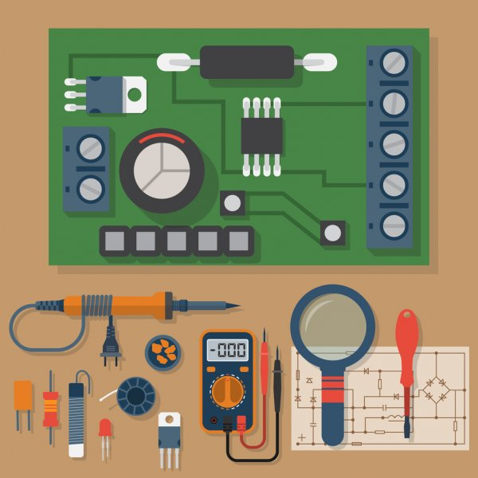
Soldering kit
It consist or various equipment's like soldering iron, wire cutter, soldering stand, safety glasses, Soldering tools for desoldering etc.

Slide 35
This is avaible in amazon .ca for CAD 28.68
https://www.amazon.ca/Soldering-Electronics-Welding-Switch-Tweezers/dp/B0882VM47R/ref=asc_df_B0882VM47R/?tag=googleshopc0c-20&linkCode=df0&hvadid=335241488547&hvpos=&hvnetw=g&hvrand=2657608807680005074&hvpone=&hvptwo=&hvqmt=&hvdev=c&hvdvcmdl=&hvlocint=&hvlocphy=9000894&hvtargid=pla-923818815789&psc=1

Slide 36
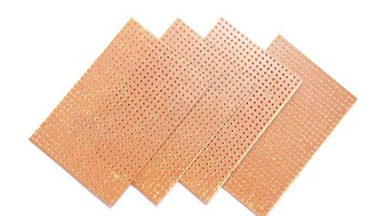
Zero PCB
Zero PCB is basically a general-purpose printed circuit board (PCB), also known as perfboard or DOT PCB
It is a thin rigid copper layer with holes pre-drilled around a grid with 2.54mm (0.1-inch) spacing between holes at standard intervals.

Slide 37
Availability
This is available in Elmwood electronics for CAD 7.99
https://elmwoodelectronics.ca/products/bakelite-universal-perfboard-plates-pack-of-10?variant=24126910531&currency=CAD&gclid=Cj0KCQiA962BBhCzARIsAIpWEL2vdOGpGtEHZWVhSFJuHkyfWG9PshE1r2g0WgMu-ZtveZOjWf1Hh7IaAlZHEALw_wcB

Slide 38
Resistors and jumper wires
Jumper wires are available in amazon.ca for CAD 12.99
https://www.amazon.ca/IZOKEE-240pcs-Solderless-Breadboard-Arduino/dp/B08151TQHG/ref=asc_df_B08151TQHG/?tag=googleshopc0c-20&linkCode=df0&hvadid=335380394635&hvpos=&hvnetw=g&hvrand=12071104075935955786&hvpone=&hvptwo=&hvqmt=&hvdev=c&hvdvcmdl=&hvlocint=&hvlocphy=9000894&hvtargid=pla-871319839190&psc=1

Slide 39
Resistors are available in Digi key for CAD 0.43
https://www.digikey.ca/en/products/detail/yageo/FMP200JR-52-10K/2058963?utm_adgroup=Yageo&utm_source=google&utm_medium=cpc&utm_campaign=Smart%20Shopping_Supplier_Yageo&utm_term=&productid=2058963&gclid=Cj0KCQiA962BBhCzARIsAIpWEL126E7Mhta5KGQd5idghnIo_f0j18u_7lNATk_aOZRP2migYniKKzEaAlV9EALw_wcB

Slide 40
Testing of the components

Slide 41
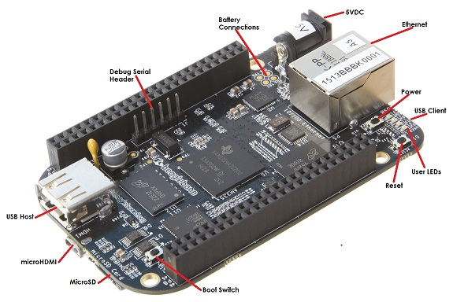
Beaglebone Black

Slide 42
The 5V DC power supply can be plugged into the DC connector.
Ethernet port is used to connect the beagle bone black to a network
Power button is used to sent interrupts to let the processor facilitate orderly shutdown to save the files.
Reset button is used to reset the board.
Boot switch is used for flash the beagle bone black.

Slide 43
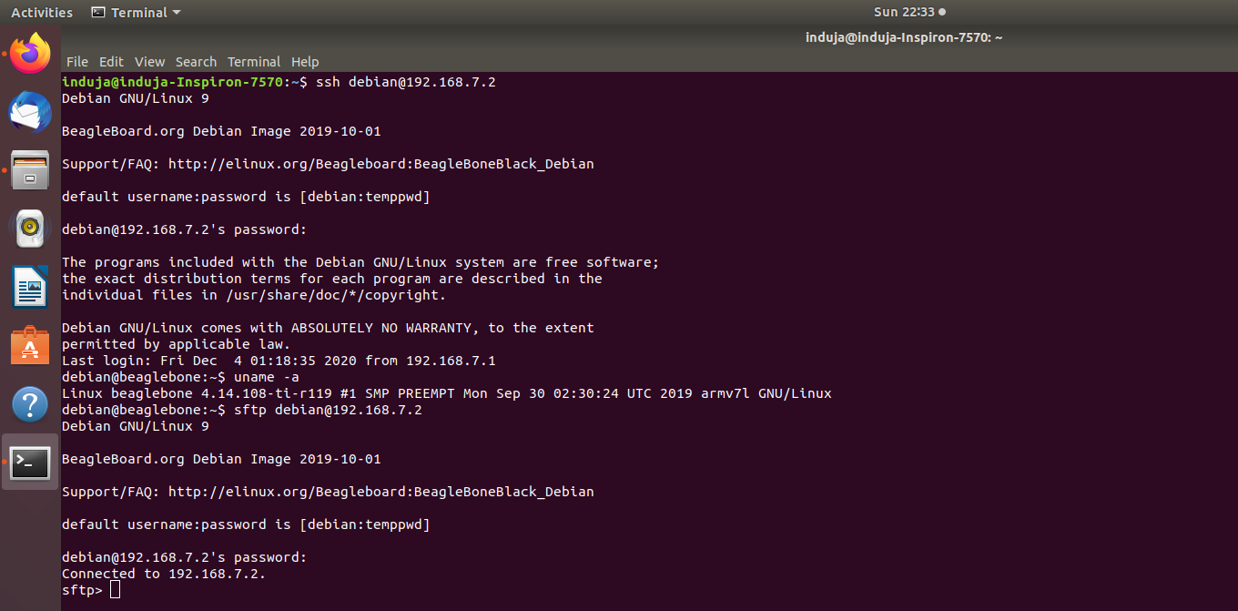

Slide 44
Soil moisture sensor(FC-28)
To perform the testing FC-28
we need…,
Arduino
FC-28
Jumper wires
The soil moisture sensor actually consist of two parts, a 2 legged lead and an amplifier or analog to digital convertor circuit.

Slide 45
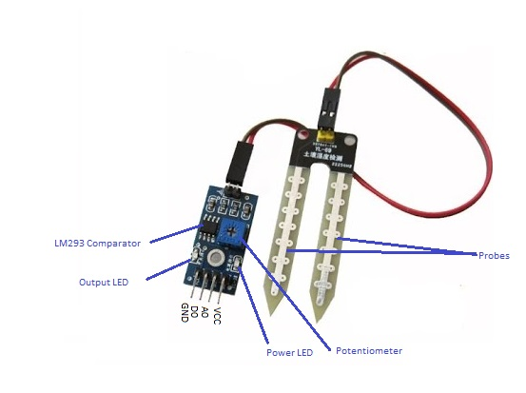
The amplifier part is connected to the Arduino using the four male headers which are labeled as VCC,GND,D0 and A0.
D0 is the digital values and A0 is for analog values. The digital output is in the form of 0 and 1 and it can be controlled by using the potentiometer.

Slide 46
The module has two LED’s , one is the power-on LED and the other LED works with the digital output pin.
If the moisture is below a certain value which is set using the potentiometer then LED remains off, when there is moisture the led turns on.

Slide 47
The analog output can be any number between 0 and 1024.
This value will entirely depend on the water content present in the soil.
Steps:
The two legged lead is connected with the amplifier with jumper Wires(there is no polarity)
VCC to 5V
GND is connected to the Arduinos GND

Slide 48
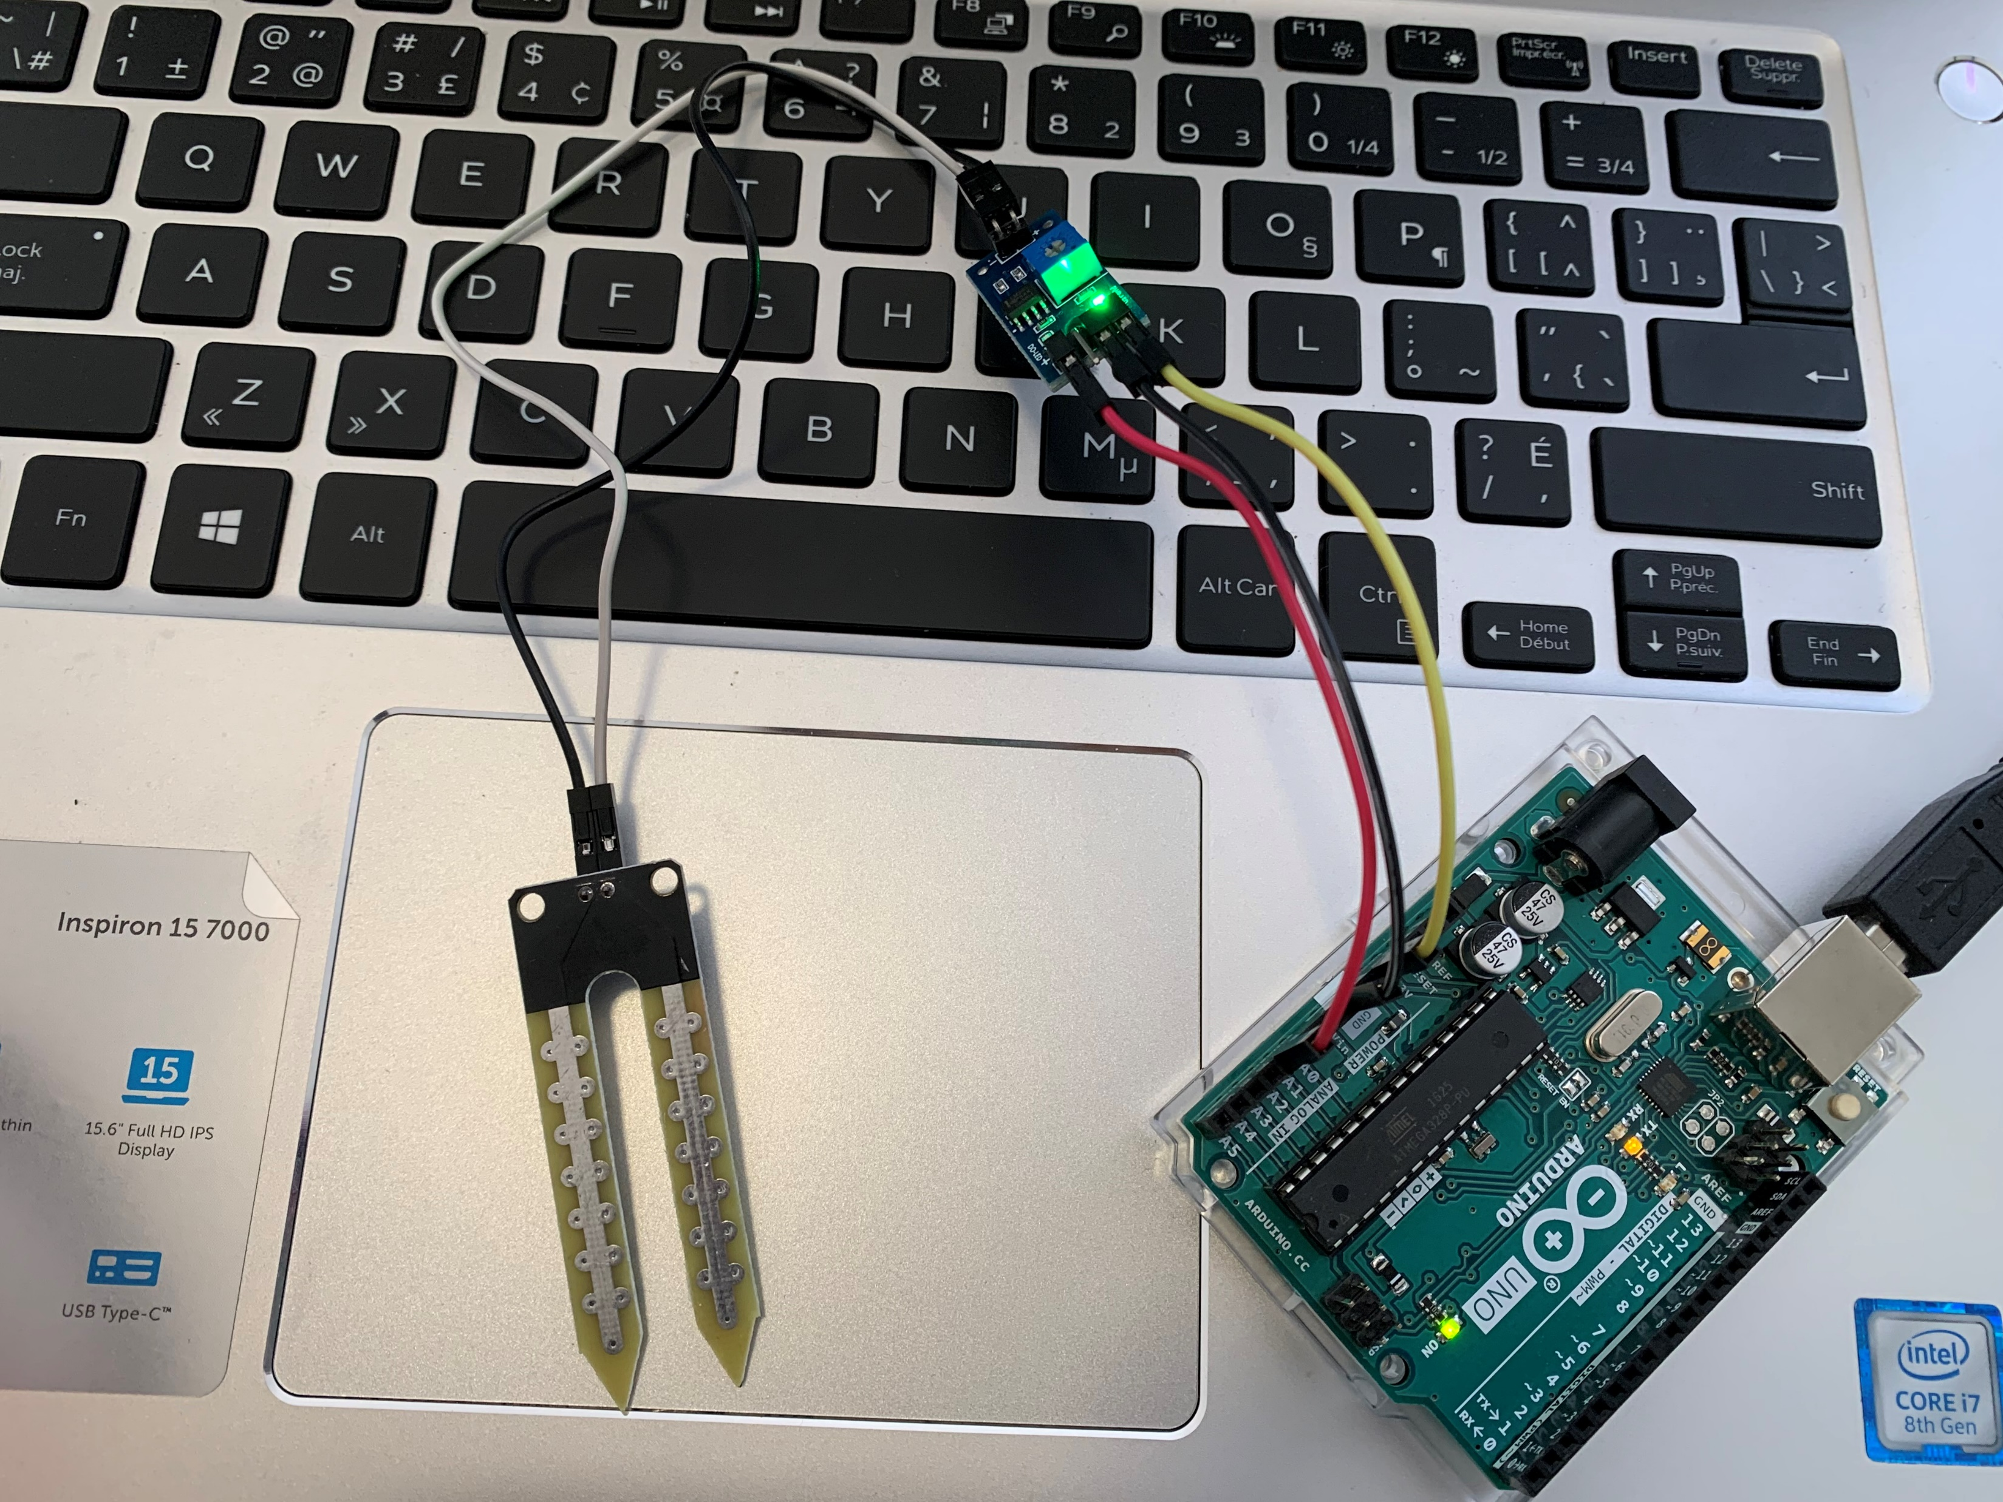
The analog output pin is connected to the pin A1 of Arduino which is an analog pin.

Slide 49
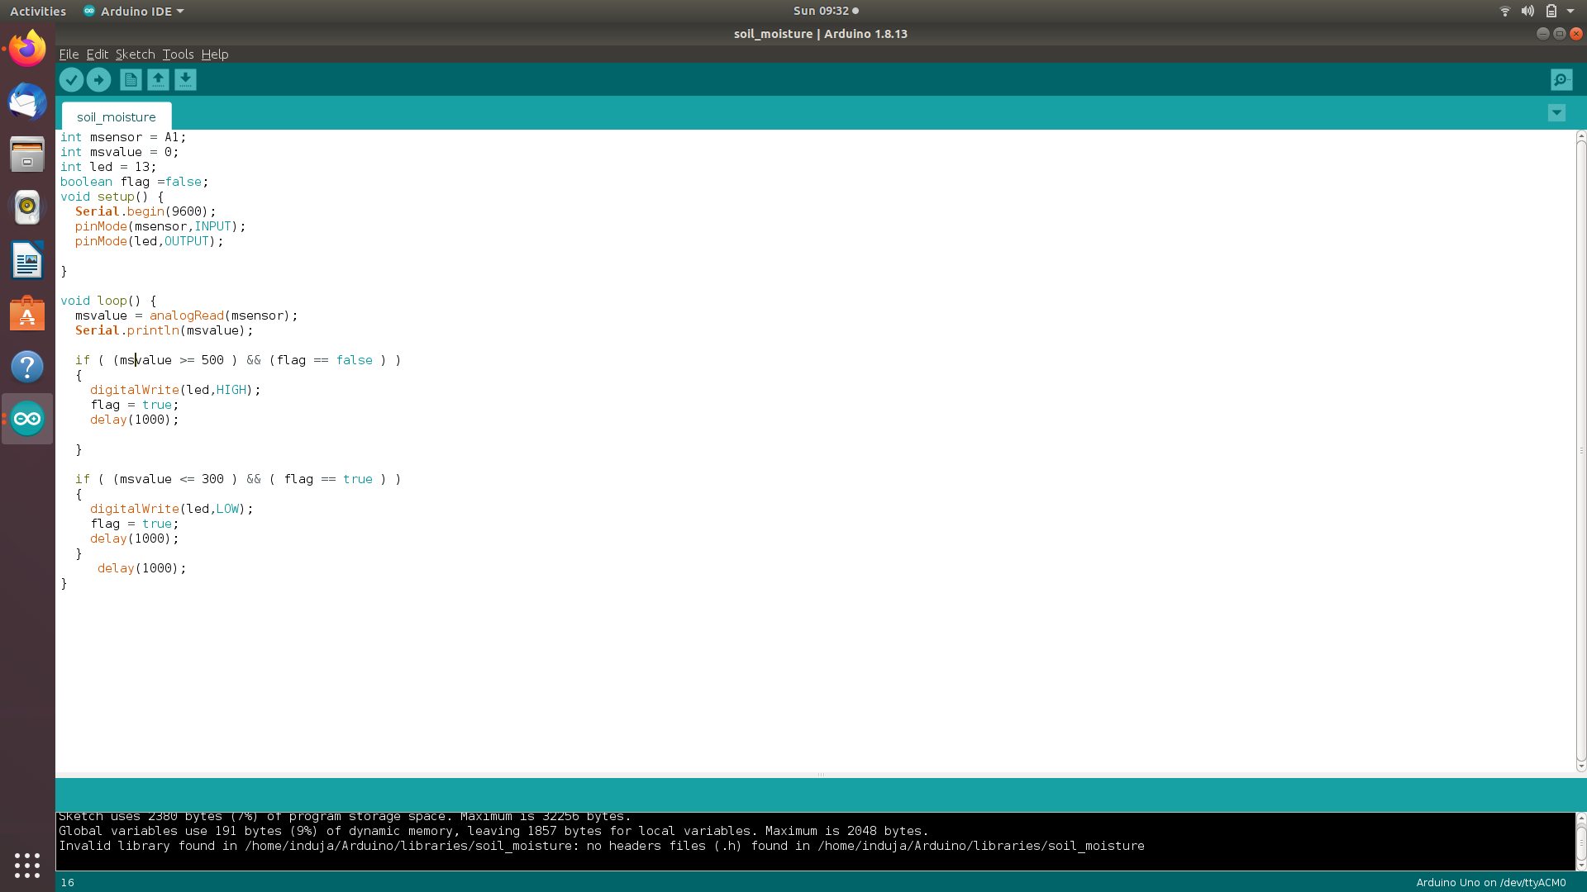
Code:

Slide 50
Open the serial monitor .
We can see that the value is 1023.
And when we try to insert the probes to the soil the value will began to drop and also the LED will be turned on.
For digital mode we can just connect the wire to digital pin and connect that to the D4 pin of Arduino.

Slide 51
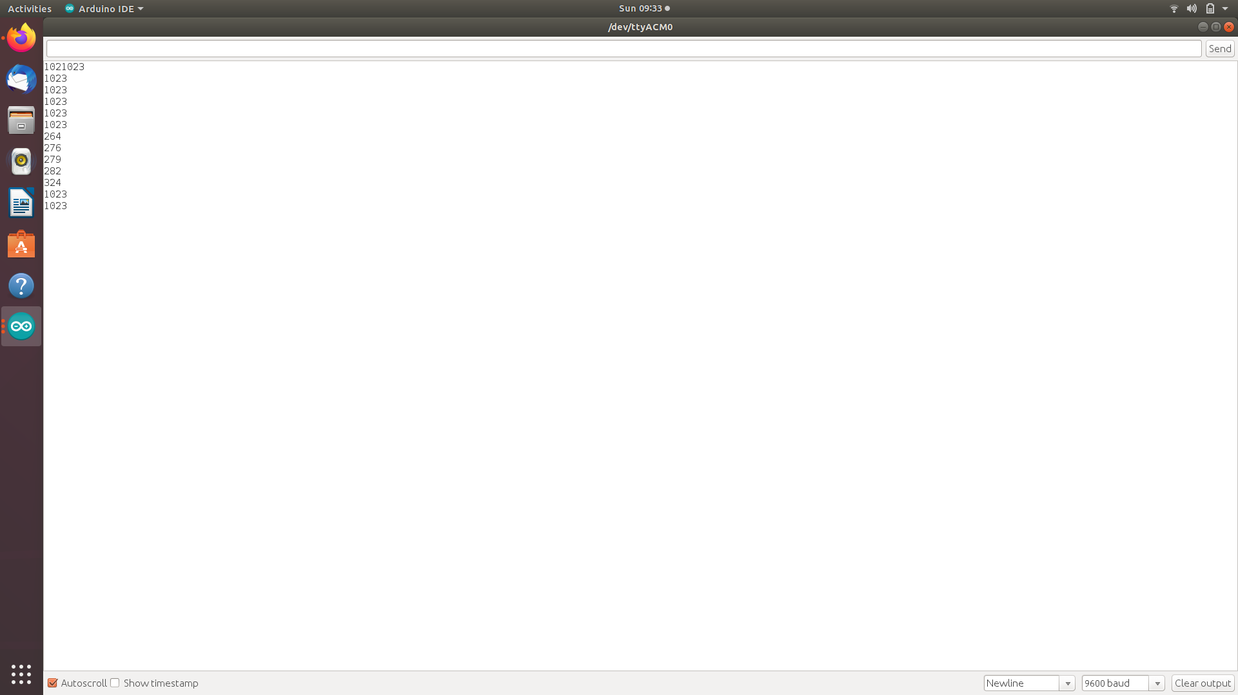
Output

Slide 52
Testing of DHT22
To perform the testing of DHT22 temperature and humidity sensor we need…,
DHT22 Sensor
Arduino
Jumper wires
Install the DHT library, which can be done through the Arduino Library Manager:
Sketch→ Include Library→ Manage Libraries…

Slide 53
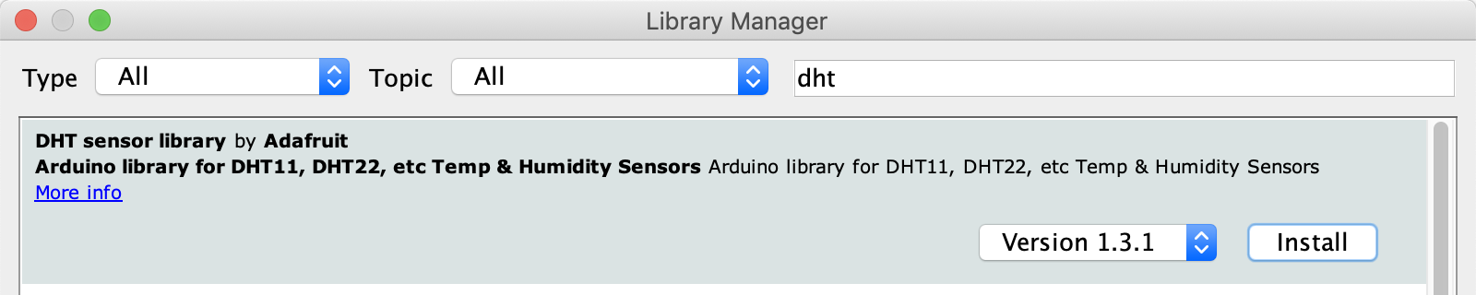
Enter “dht” in the search field and look through the list for “DHT sensor library by Adafruit.” Click the “Install” button, or “Update” from an earlier version.

Slide 54
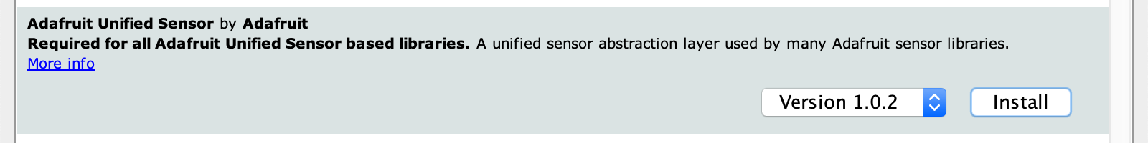
As of version 1.3.0 of the DHT library you will also need to install the Adafruit Unified Sensor library, which is also available in the Arduino Library Manager:

Slide 55
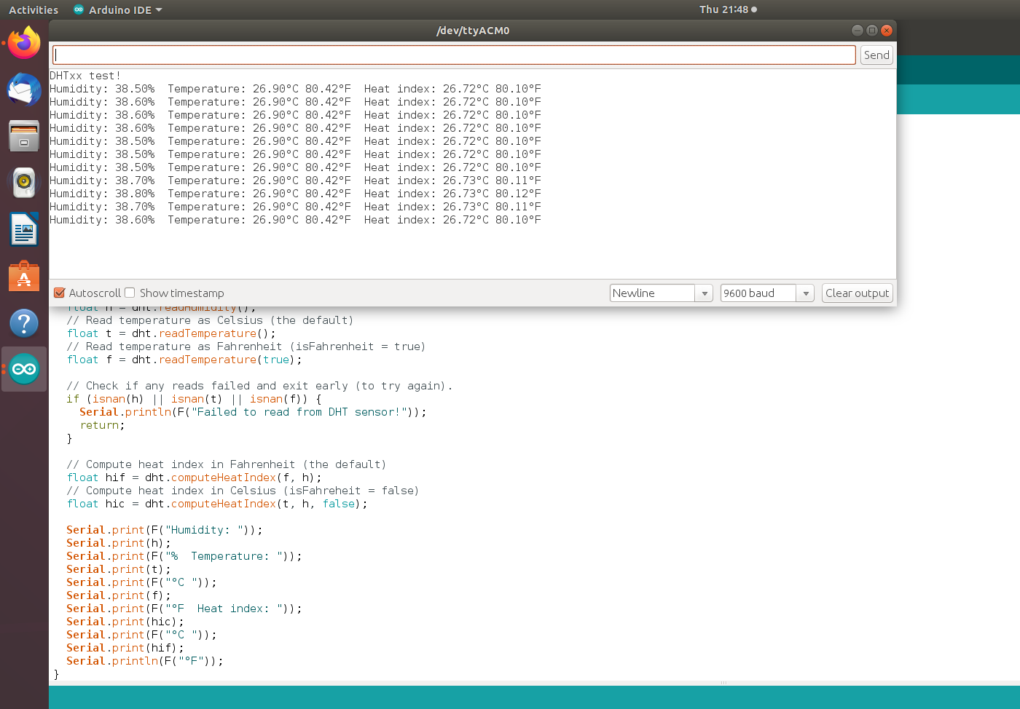
Load up the Examples→DHT→DHTtester sketch

Slide 56
Upload the sketch.
You should see the temperature and humidity. You can see changes by breathing onto the sensor (like you would to fog up a window) which should increase the humidity.

Slide 57
LDR
Its resistance varies according to the light falling on its surface.
Its surface is made of cadmium sulfate which is a light sensitive material.
When there is maximum light the resistance became low.
When there is minimum light fall or exposed to dark then the resistance increases upto several kilo ohms.

Slide 58
To perform the testing of the LDR sensor we
will need…,
Multimeter
LDR Sensor
Breadboard
Connect the leads of the ldr to the multimeter
Keep the multimeter knobs in resistance range.
The value will vary according to light.

Slide 59
ESP8266 Wi-Fi module
To perform the testing of ESP8266 wifi module we need…,
LED
Jumper wires
ESP8266 wifi module
Arduino
Breadboard

Slide 60
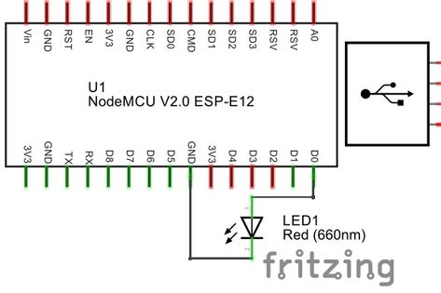
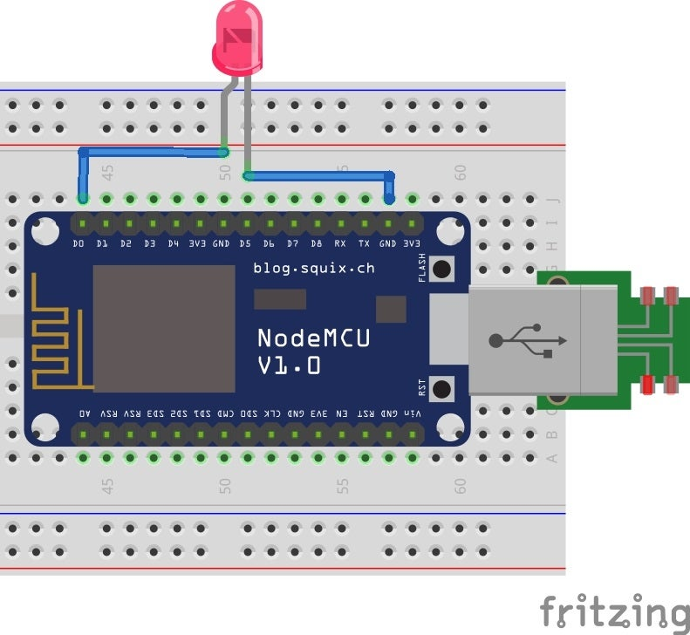
Make the connection as follows..,

Slide 61
Installing Arduino Core for NodeMCU ESP-12E Using Arduino Boards Manager.
Open Arduino and go to preference window.
Insert Link for .json NodeMCU Package Files Into Arduino IDE
Enter http://arduino.esp8266.com/stable/package_esp8266com_index.json into additional board managers URLs field.

Slide 62
Open the board manager from Tools > Board menu and install esp8266 platform(also select ESP8266 from tools > board menu after installation.

Slide 63
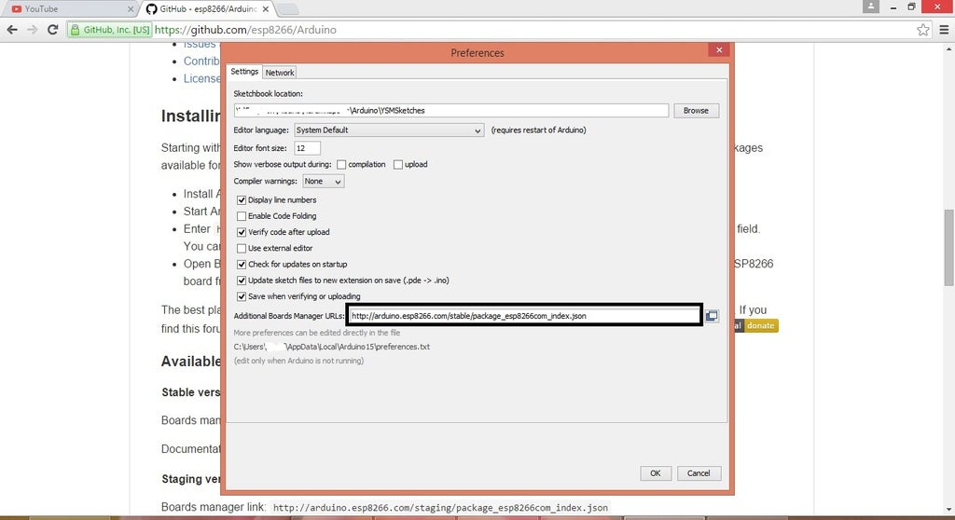

Slide 64
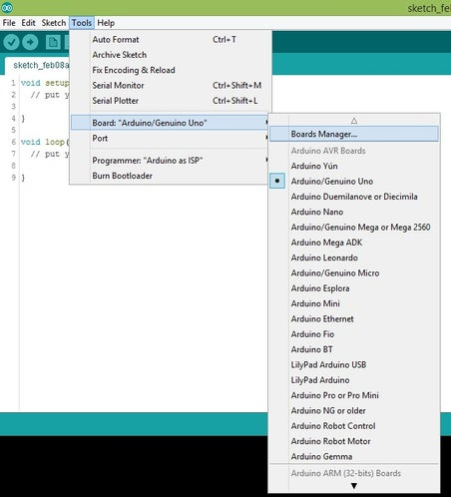
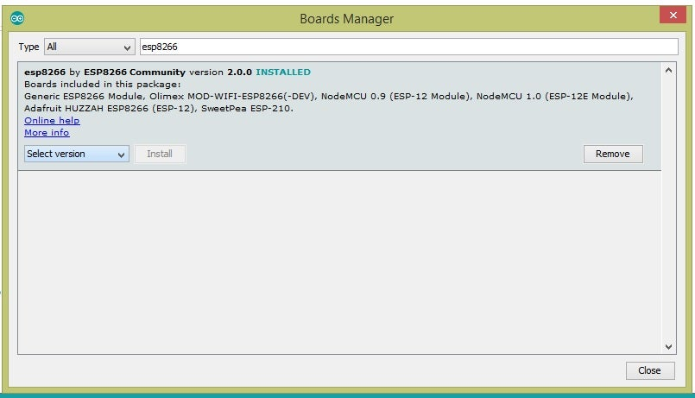
Tools - Boards manager and search for ESP8266 and install the libraries/files given under heading ESP8266 by ESP community.

Slide 65
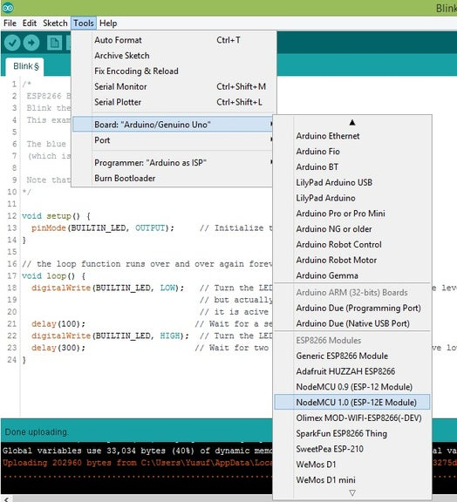
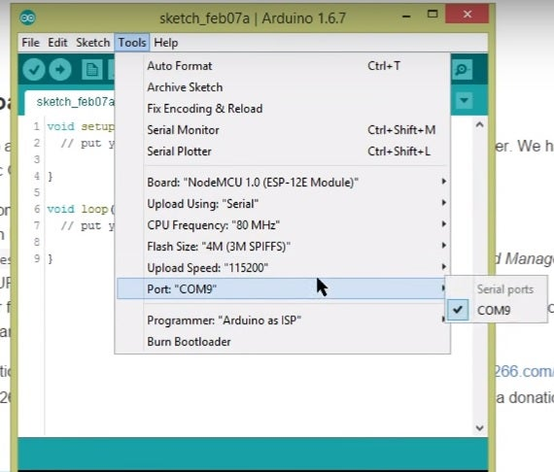
Go to Tools - Boards (scroll down the list of boards) - Select NodeMCU 1.0 ( ESP-12EModule). Select the Port number at which you have connected nodeMCU. Rest of the settings can be left to default values.

Slide 66
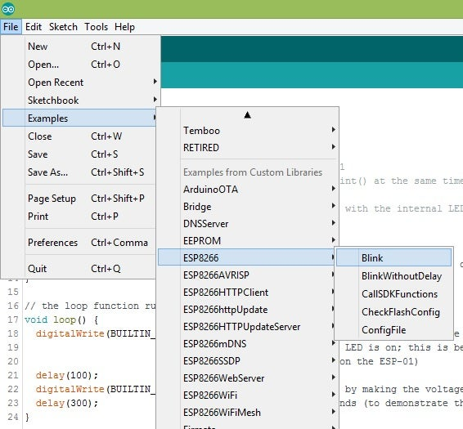
Go to File - Examples - ESP8266 - Blink

Slide 67
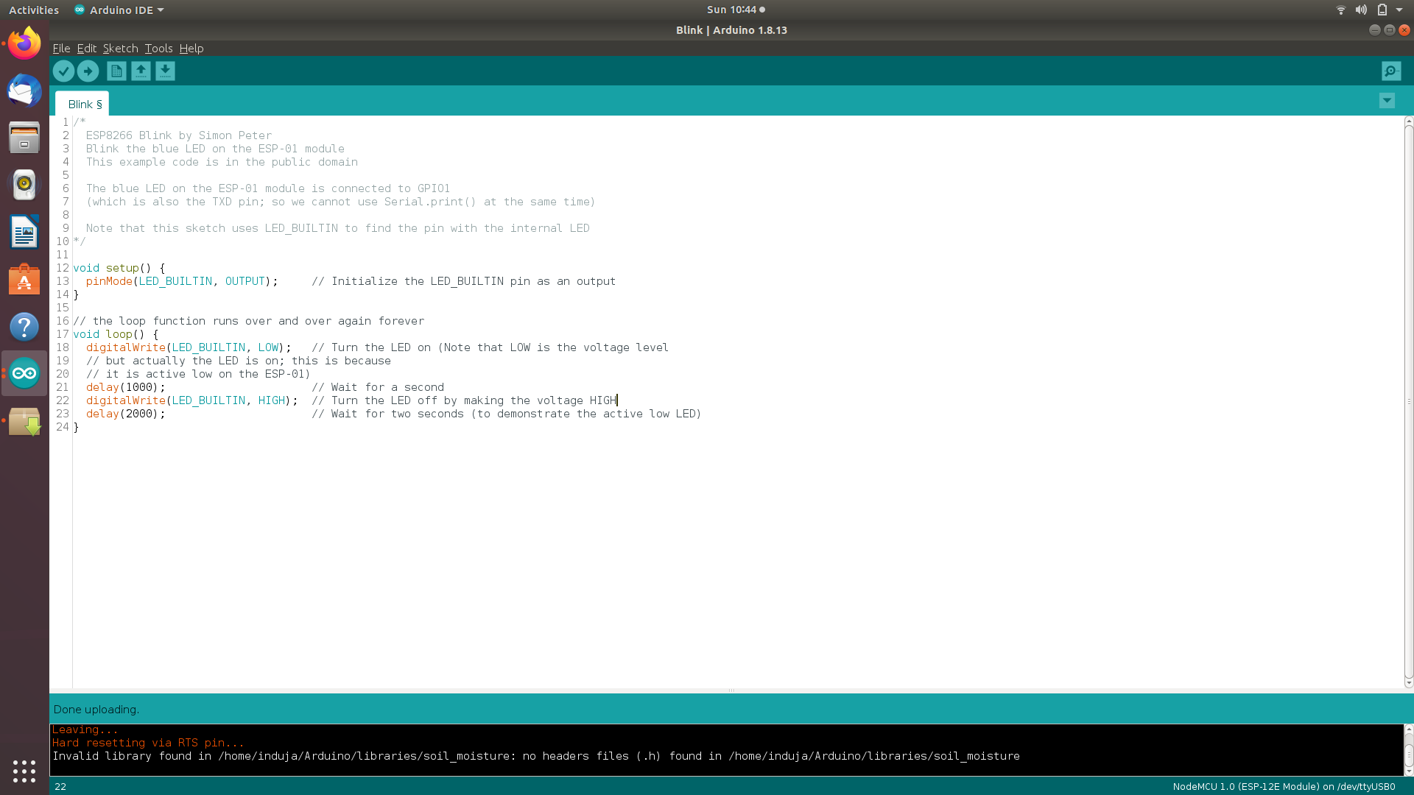

Slide 68
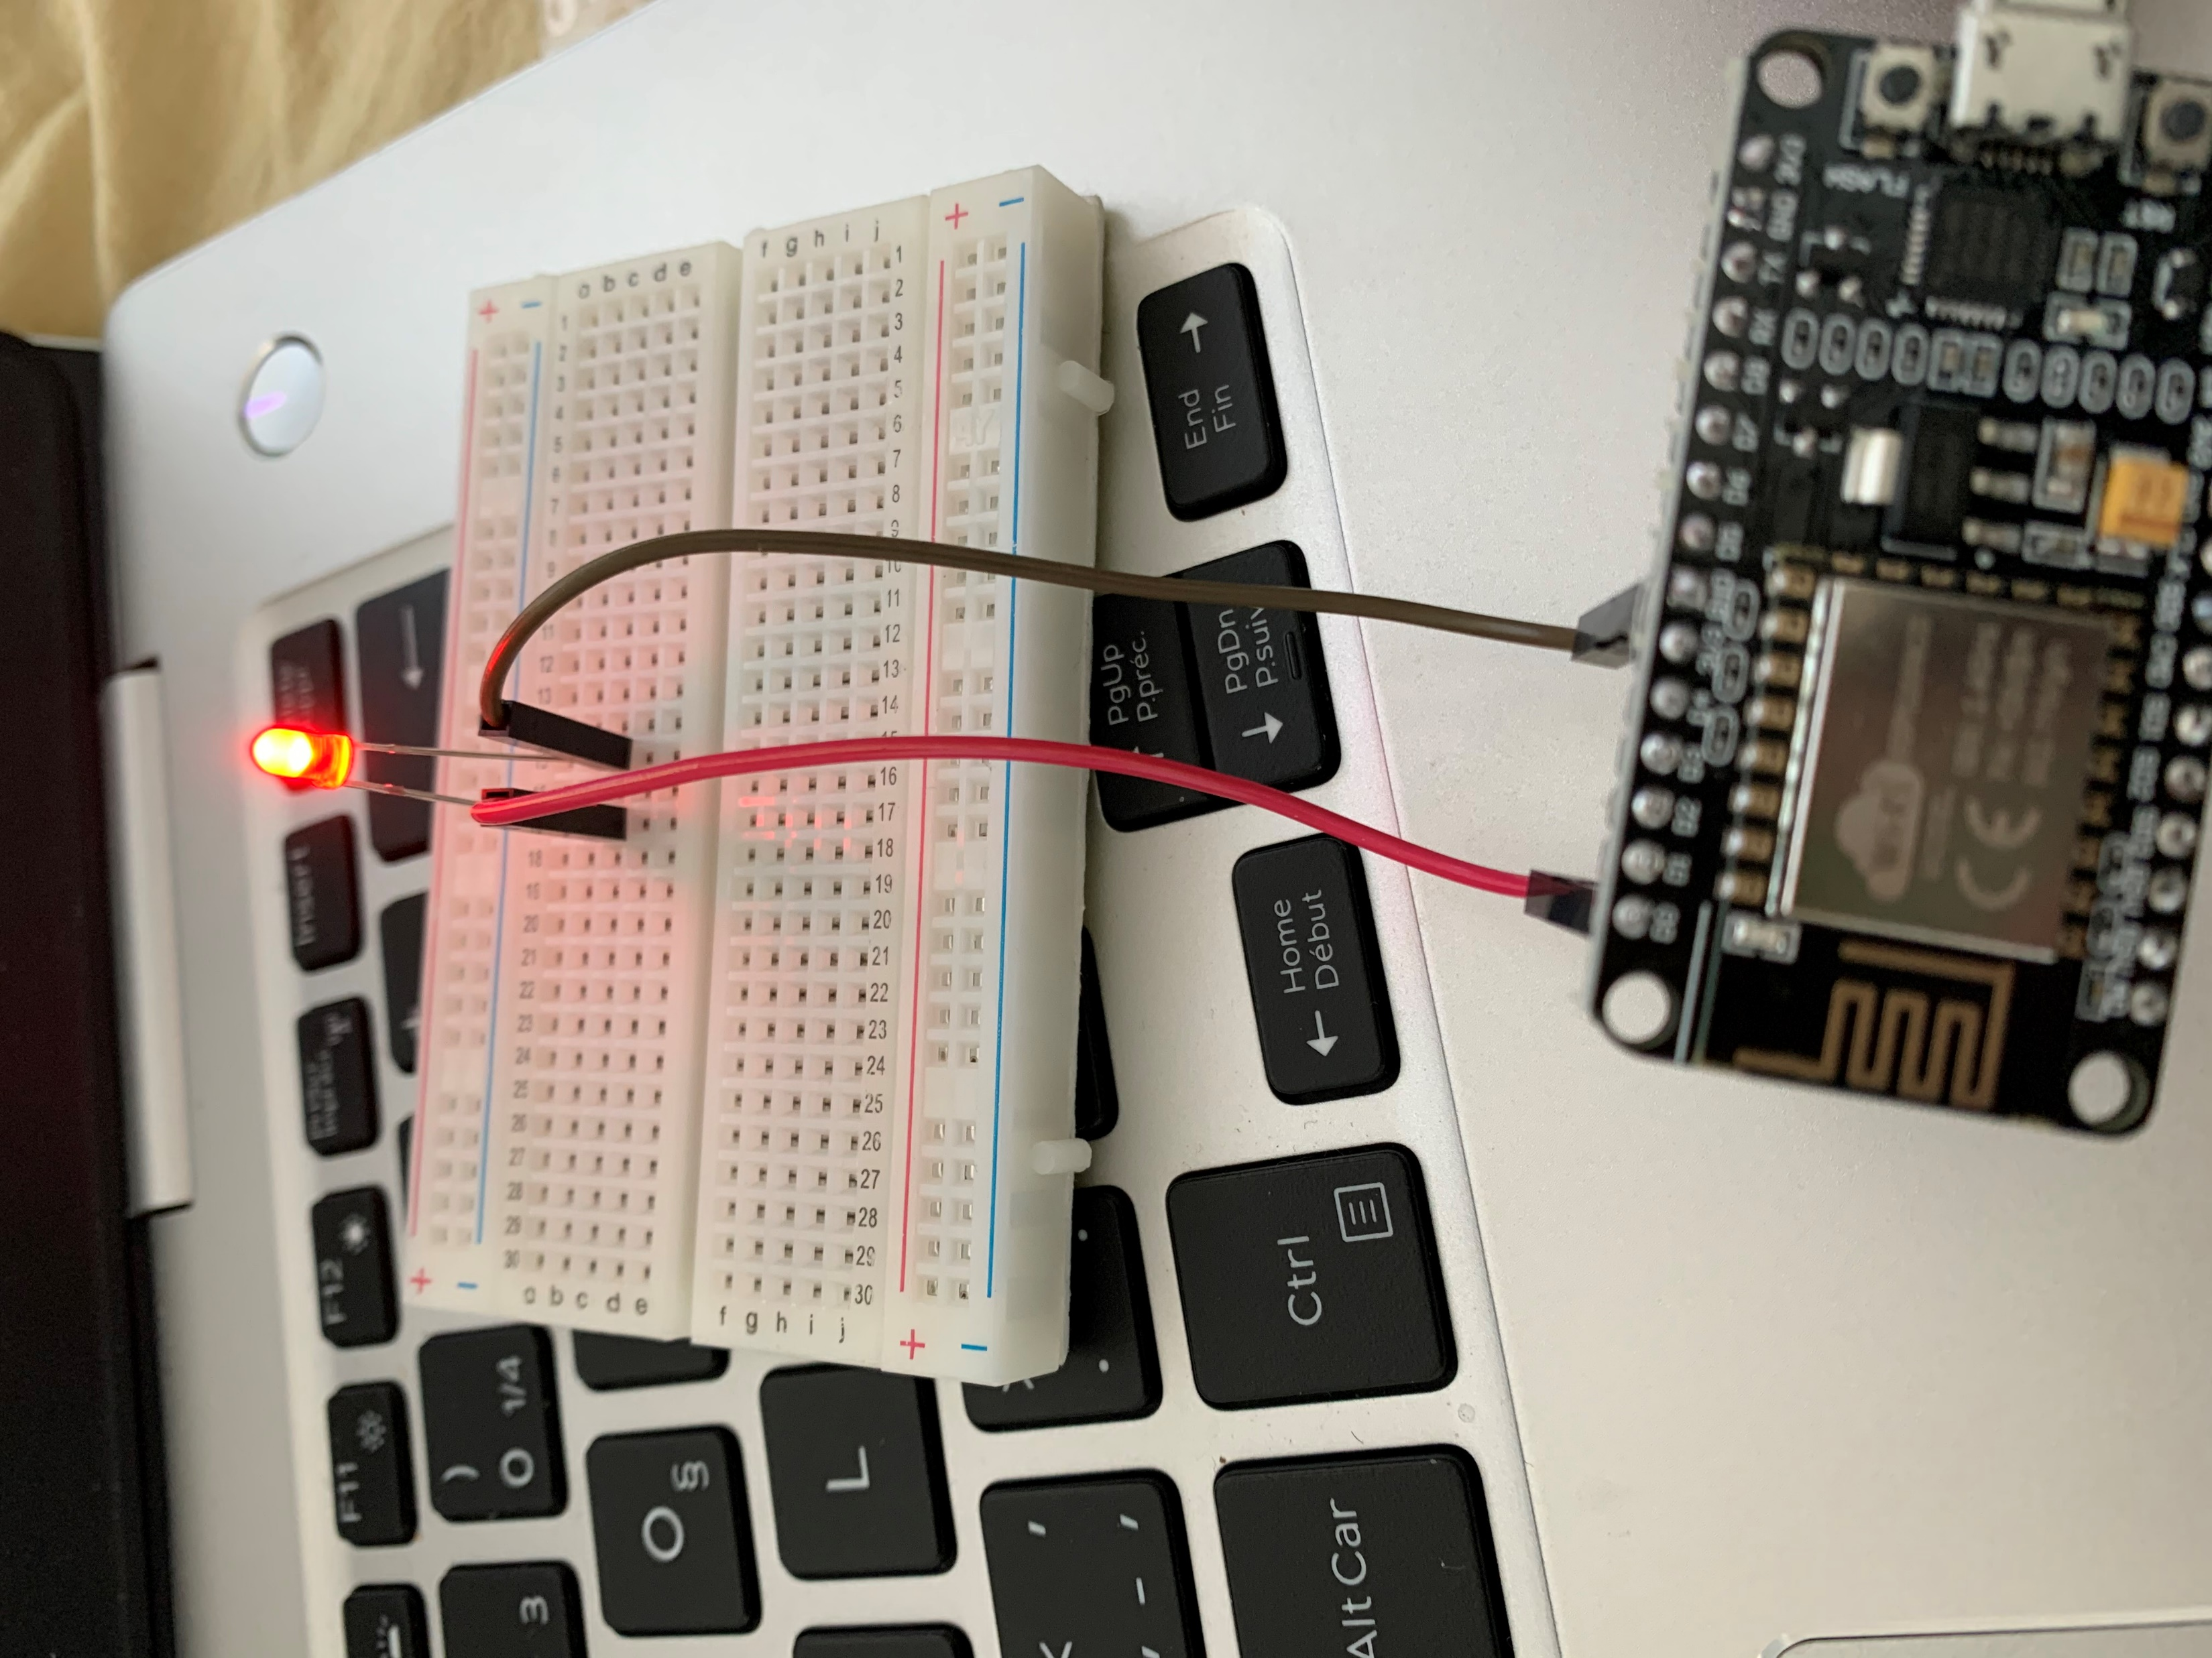
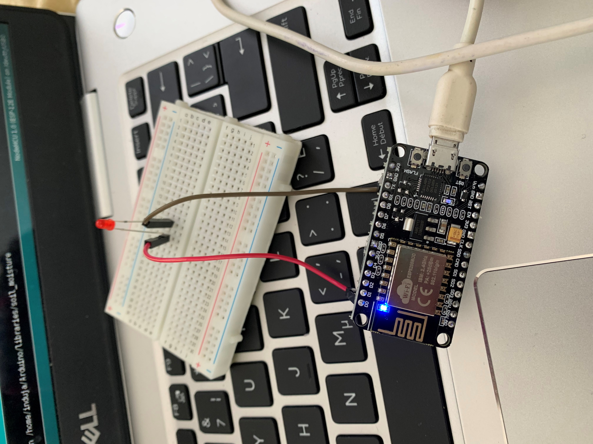

Slide 69
Motor driver(L298N)
To perform the testing of the motor driver we will need…,
Arduino
Jumper wires
Dc motor
L298N
9V Battery

Slide 70
1) DC motor 1 “+” or stepper motor A+
2) DC motor 1 “-” or stepper motor A-
3) 12V jumper – remove this if using a supply voltage greater than 12V DC. This enables power to the onboard 5V regulator
4) Connect your motor supply voltage here, maximum of 35V DC. Remove 12V jumper if >12V DC
5) GND

Slide 71
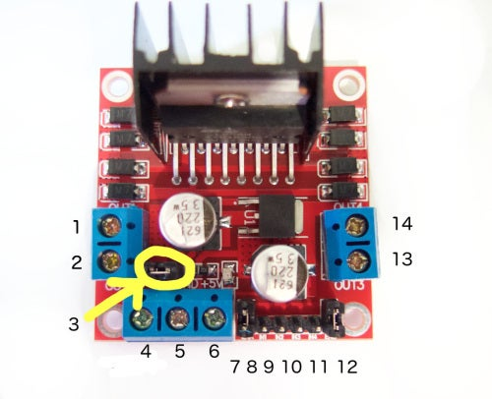
5) 5V output if 12V jumper in place, ideal for powering your Arduino
6) DC motor 1 enable jumper. Leave this in place when using a stepper motor. Connect to PWM output for DC motor speed control.

Slide 72
8) IN1
9) IN2
10) IN3
11) IN4
12) DC motor 2 enable jumper. Leave this in place when using a stepper motor. Connect to PWM output for DC motor speed control
13) DC motor 2 “+” or stepper motor B+
14) DC motor 2 “-” or stepper motor B-

Slide 73
Connect the digital pin 6 in the Arduino to IN1,pin7 to IN2,pin8 to IN3 and pin 9 to IN4.
Take a power supply and connect the positive to the 12V in the motor driver and the negative to the GND.
Take a pin to pin jumper cable and plug in one end to the same ground and take another one and connect to the 5V in l298n.
The two wires which are coming out of the l298n are connected to the Arduino
The 5v pin connected to Vin in Arduino and the other to the GND.

Slide 74
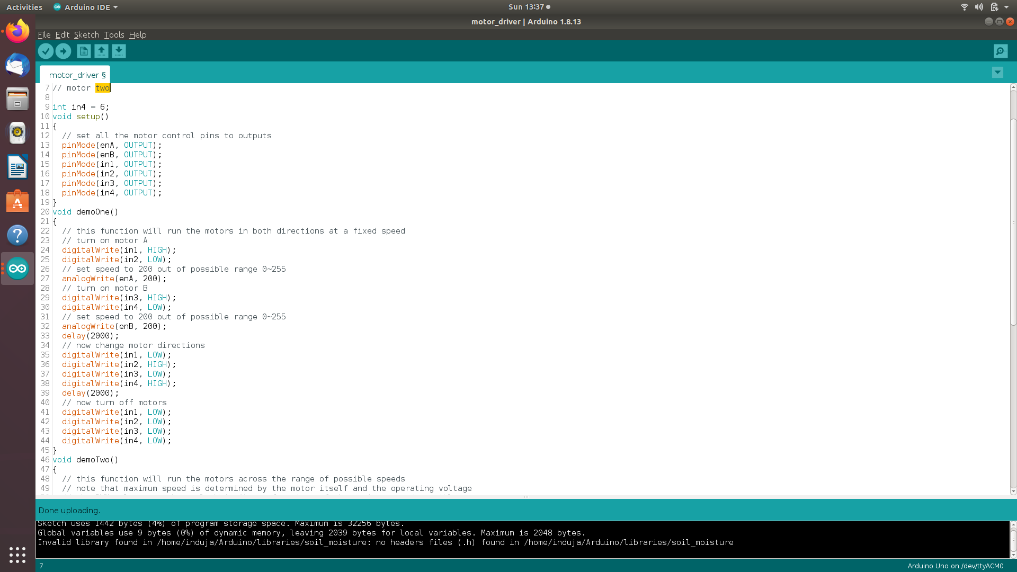
Plug the Arduino to the computer run upload the code.

Slide 75
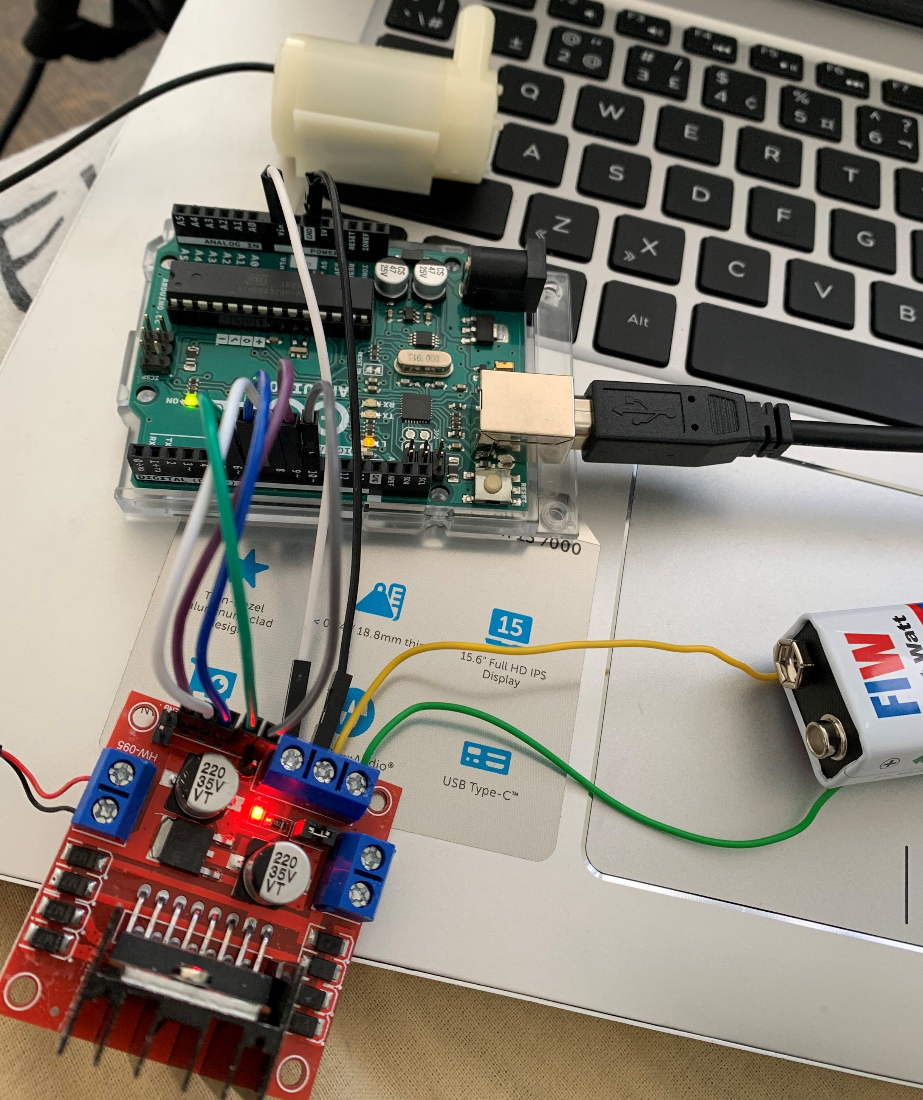
Connect the terminals of the motor to the slots in the l298n and when we put the battery in the motor will start to rotate.

Slide 76
References
Beagle bone black :https://beagleboard.org/black
DHT22 sensor:https://lastminuteengineers.com/dht11-dht22-arduino-tutorial/
LDR sensor:https://www.electronics-notes.com/articles/electronic_components/resistors/light-dependent-resistor-ldr.php

Slide 77
Zero pcb:https://www.electronicsforu.com/technology-trends/learn-electronics/veroboard-zero-pcb-difference
Soil moisture sensor:https://maker.pro/arduino/projects/arduino-soil-moisture-sensor
Wifi module:https://www.sparkfun.com/products/17146

Slide 78
Motor driver:https://components101.com/articles/what-is-motor-driver-h-bridge-topology-and-direction-control
Getting started with beaglebone black:https://beagleboard.org/getting-started
Testing of soil moisture sensor: https://maker.pro/arduino/projects/arduino-soil-moisture-sensor

Slide 79
Testing of DHT22:https://learn.adafruit.com/dht/using-a-dhtxx-sensor
Testing of LDR sensor:https://www.circuitstoday.com/how-to-test-an-ldr#:~:text=LDR%20(light%20dependent%20resistance)%20can,resistance%20will%20be%20around%20200K.

Slide 80
Testing of Wifi module:https://www.instructables.com/Programming-ESP8266-ESP-12E-NodeMCU-Using-Arduino-/
Testing of motor driver:https://www.instructables.com/Control-DC-and-stepper-motors-with-L298N-Dual-Moto/

Slide 81
Thankyou

